Slide 1
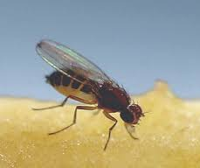
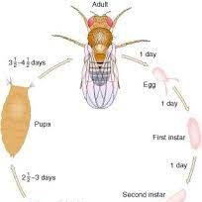
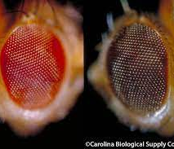
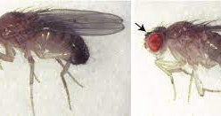
Mating: Sepia females with wild type males
Monohybrid cross
Predict the F1 generation?
Autosomes
se/se X wt/wt
=
se/wt (wild type/heterozygous)
150 (All wild type)
F2?
Se/wt X se/wt
Phenotypic ratio: 3:1
Genotypic ratio 1:2:1

Slide 2
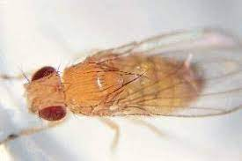
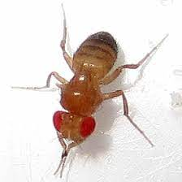
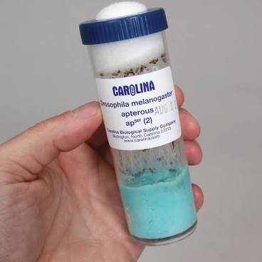
Matings: Sepia female with apterous male Dihybrid Cross
Se/se wt/wt X wt/wt apt/apt
Predict the F1 Generation?
Se/wt.
wt/apt
wt/apt
All the f1 flies are Wild type (70 all wt)
F2
wt/wt; wt/se; apt/wt, se/apt
9:3:3:1?

